Slide 1

Welcome
We’ll be starting shortly…
It’s recommended that you use headset for better audio quality
This session will be recorded….

Slide 2

FAIR-by-Design Methodology for Learning Materials
Sonja Filiposka, UKIM
orcid.org/0000-0003-0034-2855

Slide 3

Set Yourself Up For Success
Notes:
https://partici.fi/91595077

Slide 4
Why FAIR Learning Materials?
Enhanced discoverability
Contributes to a global learning community
Promotes sharing and adaptation
Supports open education
Saves time and resources
Facilitates collaboration
Makes learning more inclusive
Increased reusability
Easily find learning materials
Improved accessibility

Slide 5
FAIR for ALL
Learners
Instructors
+
Find existing materials, access their editable versions, fully understand the context and reuse according to the licensing terms.
Find learning content that can be easily accessed using common tools. Come back and revisit whenever needed.

Slide 6
FAIR requires commitment
New skills
Know about metadata schemas, PIDs, repos, licensing, attribution, open file formats
Time… more time
Needed to provide full context and improve reusability.
Fast
Easy
Quick Fix
Devil is in the details
Materials accompanied with an instructor kit have more value
By design
FAIRification may require substantial redo
Just share

Slide 7
Q: Which of the following best describes the essential characteristics of learning materials designed according to the FAIR principles?
Materials are easily discoverable through general search engines, available in a variety of file formats, and licensed for free distribution.
Materials are assigned unique, persistent identifiers; accompanied by rich, machine-readable metadata; compatible with diverse educational platforms; and licensed to allow for adaptations and reuse.
Materials are stored in a centralized online repository, accessible to registered users, and periodically updated by the original author.
Materials are formatted in a standard document type, include a detailed table of contents, and are accompanied by user feedback forms.

Slide 8
Minimum FAIR Requirements
F
Metadata is provided in human- and machine-readable format
Resource is indexed in at least one searchable repository
A
Accessibility of all learning resource files checked
Access rules (authentication & authorisation) defined for the learning resource
I
The RDA minimal (or domain specific) metadata schema is used
Resource is available in open file formats
R
Clear attribution is provided for all reused resources with compatible licenses
Resource has a permissible license that allows derivations

Slide 9
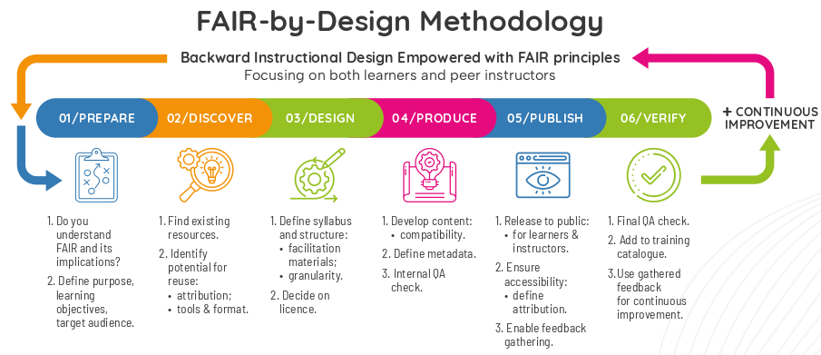
FAIR-by-Design Methodology

Slide 10
Zoom to prepare

Slide 11
1 - Prepare
Package of:
min 1 learning outcome
lesson plan
lesson content
activity desc
assessment
facilitation guide
Define:
Purpose
Target audience
Prerequisites
Scope
Learn FAIR
Use Backward Instructional Design
Formulate Learning Objectives
Define FAIR Learning Objects
Ideate
FAIR principles know how
How to deal with IPR
(RDA min) metadata schema
Focus on the learning outcomes that one wants to achieve. Work backward to the topics that need to be covered to achieve the learning objectives
Describe what new knowledge and skills will be obtained in a specific, measurable, attainable, relevant and time-bound (SMART) way
Use the Bloom’s Taxonomy

Slide 12

The RDA Minimal Metadata for Learning Resources
Minimum set of metadata for learning resources by Hoebelheinrich, Nancy J, Biernacka, Katarzyna, Brazas, Michelle, Castro, Leyla Jael, Fiore, Nicola, Hellström, Margareta, Lazzeri, Emma, Leenarts, Ellen, Martinez Lavanchy, Paula Maria, Newbold, Elizabeth, Nurnberger, Amy, Plomp, Esther, Vaira, Lucia, van Gelder, Celia W G, & Whyte, Angus. (2022). Recommendations for a minimal metadata set to aid harmonised discovery of learning resources on Zenodo licensed under CC BY 4.0

Slide 13
When and Why to Develop Full Metadata
Prepare Stage – Draft basic metadata (title, author, keywords, audience, expertise level).
Design Stage – Add most info to metadata (syllabus) following the metadata schema, except PID
Publish Stage – Validate and review metadata for accuracy before publishing, Add PID.

Slide 14
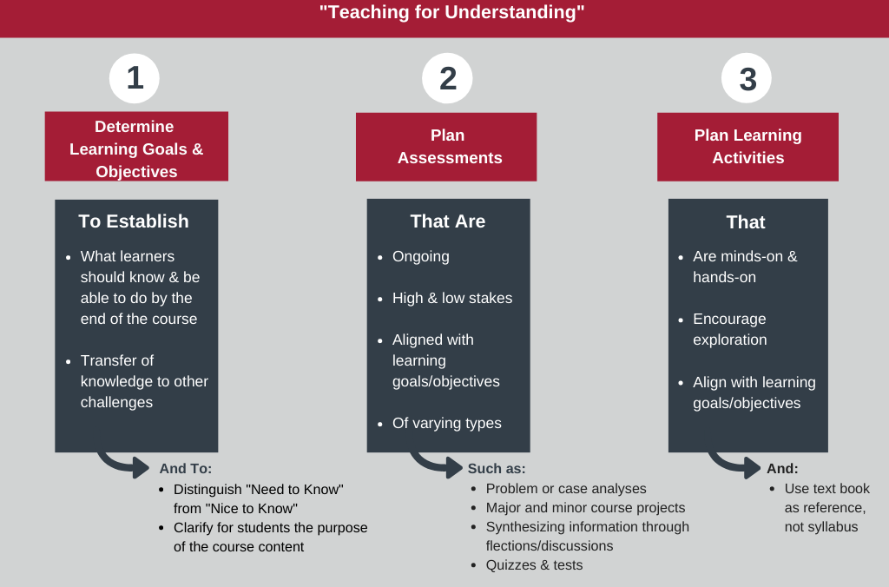
Backward Instructional Design
"Backward design model" from Muhlenberg College licensed under the CC BY-NC 4.0.

Slide 15
Context + Target Audience
Content Relevance and Contextualization
Different disciplines require learning materials that reflect their unique practices and terminology.
Example: For life sciences, materials might focus on data sharing in biomedical repositories, while for humanities, they might emphasize metadata for digitized historical texts.
Discipline-Specific Challenges
Researchers in various fields face different challenges regarding the same topic.
Ex. Social sciences: ethical concerns
Physics: Large-scale datasets and interoperability
Addressing the specific challenges in the learning materials makes them more actionable.
Target audience
Knowing the range of disciplines helps ensure the content is relevant to everyone while still offering practical, tailored examples.

Slide 16

Learning Objectives: Bloom’s Taxonomy Verbs
Bloom's taxonomy by Fractus Learning. (2023, July 10). In Wikipedia licensed under the terms of CC BY-SA 4.0.

Slide 17
Q: Which learning objectives are the MOST SMART and effectively address the practical application of controlled vocabularies in a research data management context?
"Participants will be able to discuss the theoretical advantages of controlled vocabularies in metadata creation."
"Participants will learn how to navigate and select terms from at least two online controlled vocabulary repositories."
"Within one hour, participants will be able to accurately map 80% of a given set of diverse research data elements to corresponding terms from a pre-selected, domain-specific controlled vocabulary, demonstrating consistency and precision."
"Participants will understand the importance of using controlled vocabularies to improve data findability."

Slide 18
Think SMART
Specific:
Measurable:
Achievable:
Relevant:
Time-bound:
Domain-specific:
It details the action (mapping), the target (data elements), the source (controlled vocabulary), and the desired outcome (consistency and precision).
It sets a clear percentage (80%) and a time limit (one hour).
While challenging, it's realistic within a training setting with appropriate guidance.
It directly addresses a practical application in research data management.
It includes a specific time constraint.
this adds the layer of needing to understand the importance of domain specific vocabularies.
Consistency and precision:
adds a layer of quality to the metric.

Slide 19
How to make SMART learning objectives
Specific
Clearly define what the learner will achieve. Avoid vague terms like “learn” or “understand.”
✗: “Learn about Open Access publishing.”
✓: “Identify and describe the differences between Gold, Green, and Hybrid Open Access models.”
Measurable
Use criteria to track progress and determine when the goal is achieved.
✗: “Understand Open Access policies.”
✓: “List three key funder Open Access requirements and explain how to comply with them.”
Achievable
Ensure the objective is realistic given the resources, time, and learner’s abilities.
✗: “Convert all previous publications to Open Access in one month.”
✓: “Locate an Open Access repository and submit one preprint of your current research within two weeks.”
Relevant
Align the objective with the overall learning goals and learner’s needs.
✗: “Memorize the history of Open Access.”
✓: “Explain how Open Access supports the principles of Open Science and increases research impact.”
Time-bound
Specify a deadline or time frame for achieving the objective.
✗: “Adopt Open Access practices.”
✓: “Develop an Open Access publication strategy for the next research project by the end of the semester.”

Slide 20
The stages

Slide 21
Discover

Slide 22
2 - Discover
Get Inspired!
OER
EOSC
General
Multimedia
DOAB
MERLOT
OASIS
OER Commons
OERTX CORA
GALILEO
FORRT
Most EOSC projects have their own training catalogues and/or platforms
OpenPlato
Provide for all learning modalities:
Read/write
Auditory
Visual
Kinesthetic
Discovery is a lengthy, windy process
Closed learning resources have value too
Creative Commons Search
Zenodo
OSF

Slide 23
Q: Imagine you are searching for existing learning resources to reuse in your module on "Introduction to Open Access." What keywords or phrases would you use in your search to maximize the chances of finding relevant and reusable materials?
Consider different aspects of your topic, such as the tools, techniques, and concepts involved.
Think about the level of expertise you are targeting.

Slide 24
Effectively search for existing learning materials
1. Be Specific and Contextual
Use keywords that reflect the learning material’s topic, discipline, and intended use.
Examples:
“Open Access publishing tutorial”
“FAIR metadata humanities”
“Self-paced course on data ethics”
2. Use Synonyms and Related Terms
Different repositories or creators may describe the same concept using different terms.
Examples:
Instead of only searching for “FAIR data,” try “data stewardship,” “open data management,” or “research data sharing.”
Include alternate terms: “educational resources,” “teaching materials,” or “learning modules.”
3. Include Metadata Elements as Keywords
Search using metadata elements, such as:
Target audience: “FAIR data for early-career researchers”
Format: “Interactive tutorial,” “MOOC,” “PowerPoint slides”
Licensing: “Openly licensed teaching materials”
4. Combine Keywords for Advanced Searches
Use Boolean operators to combine multiple terms and narrow or broaden your search.
5. Search in Specialized Repositories
Focus on repositories and platforms that host educational resources

Slide 25

Reusing existing content
Before you reuse any existing content check the license
Content MUST be available under a permissible license
If the content is not available under a permissible license you can
Only cite it
Reach out to the owner and ask for permission for reuse
Best to stick to content available under CC (or similar) licenses
Even then you need to be careful
This Photo by Unknown Author is licensed under CC BY-SA-NC

Slide 26


Creative Commons Licenses
Taken from Creative Commons license Wikipage (2023, June 21) in Wikipedia licensed under the Creative Commons Attribution-ShareAlike License 4.0 / cropped

Slide 27
Attribution
Moral right - always needed
Everything you reuse MUST be attributed to the author
How to attribute:
If supplied, you must provide
the title of the material
the name of the creator and attribution parties,
a copyright notice,
a license notice,
a disclaimer notice, and
a link to the material
Check if the author has a preferred way for attribution
Use the TASL method
NO ?

Slide 28
How to attribute?
The ideal attribution = TASL
Title - what is the name of the work
Author - who allows you to use the work (name and link)
Source - where can the work be found (link added to title)
License - how can the work be used (name and link to the license)
CC Recommended practices for attribution
Title
Author
Source
License

Slide 29
Attribution examples
Image attribution
"Creative Commons 10th Birthday Celebration San Francisco" by Timothy Vollmer is licensed under CC BY 4.0
Adapted image attribution (if derivatives are allowed)
"Creative Commons 10th Birthday Celebration San Francisco" by Timothy Vollmer is licensed under CC BY 4.0 / Cropped from original
Text attribution
This chapter is from “You Don't Know JS Yet (2nd Edition)” by Kyle Simpson. The book is licensed under the CC BY-NC-ND 4.0 license. © 2019-2022 Kyle Simpson.
Provided by source
Image by AUTHOR(link) from Pixabay(link)

Slide 30
Q: You decided to incorporate a video clip into your "Advanced Data Analysis Techniques" module. The video is licensed under CC BY-SA 4.0. Which of the following attributions is MOST compliant with both the license terms and copyright law?
"Video: [Video Title], Creator: [Creator Name], CC BY-SA 4.0"
"Video [Video Title] by [Creator Name] is licensed under CC BY-SA 4.0. Copyright [Year] [Creator Name]."
"This video is used under Creative Commons license. Find more at [Link to Video]."
"Video courtesy of [Creator Name]. All rights reserved."

Slide 31
Attributing materials from multiple sources
So you want to reuse pieces from different places
Each should have permissible license
Each source should have its own attribution based on TASL
It should be clear which attribution belongs to which work
Divide into sections if applicable
Provide attribution for each section
Just one piece from a given source?
Provide attribution before the piece itself

Slide 32
Stages again

Slide 33
design

Slide 34
3 - Design
Create granular learning resources that can be easily reused
Mix and match discovered and new
A document that represents the organizer view and aims to enable a smooth and efficient delivery
Concept
Develop
Feedback
Facilitation Guide
Structure
Learning unit plan
Content
Activities
Assessment
Learners should be able to provide feedback on what worked well and what should be improved
Sketch a content concept map
Prepare a syllabus

Slide 35
Syllabus
Organise your learning concepts into an instructional sequence
Outline / Agenda / ToC
Instructional sequence becomes a blueprint for the structure of the learning materials
defines the core of the syllabus
Ensure the syllabus contains all fields from the RDA min metadata schema
human-readable metadata available to all

Slide 36
Syllabus Elements
Title
Description
Target audience
Primary Language
Prerequisites?
Duration
Certification Information
Author(s)
PID
Accessibility Mission
Type
Date/Time
Location
Expertise Level
Access Cost
Learning objectives
Keywords
Agenda
Resources and Materials
Trainer(s)?
Contact information
License

Slide 37
Q: When designing learning materials for optimal reusability and adaptability within diverse educational contexts, which approach to granularity and organization is MOST effective?
Creating a single, comprehensive document or video covering all aspects of the topic.
Dividing the content into small, self-contained learning objects (e.g., microlearning modules) that can be easily rearranged and repurposed.
Organizing the material chronologically, following the historical development of the subject.
Structuring the material based on the instructor's personal preferences and teaching style.

Slide 38
Logical organisation
Root
resources
questions file
(opt) 01 Section
(opt) 01 Module
01 Learning Unit
Activities
01 activity details
...
N activity details
Assessment
question bank
(opt) strategy
Learning content
Slide deck
Learning unit plan
...
N Learning Unit
syllabus
facilitator guide
README
LICENSE
CITATION
CODE-OF-CONDUCT
Feedback

Slide 39
Q: Which Creative Commons license is generally BEST for learning resources if we are looking to maximize reuse?
CC BY
CC BY-NC
CC BY-SA
CC0

Slide 40
When to use
When to Use CC-BY:
Academic Research: When you want your work to be widely shared and used but still retain credit for your contributions.
Creative Works: If you want to allow others to remix or build on your work but insist they give you proper credit.
Publicity/Recognition: If you want your work to be shared freely but want to ensure your authorship is always acknowledged.
When to Use CC0:
Maximize Sharing and Usage: If your goal is to contribute to the public domain and have your work freely used without any limitations or obligations (including attribution).
Creative Commons for the Public Good: When you want your work to be adopted or reused without concern for attribution (e.g., educational content, artworks, software).

Slide 41
Combining and Remixing CCs
Combining = combine learning materials from different sources available under different licenses
you may combine any CC-licensed content as long as you provide attribution and
Remixing = derivative = adaptation => when the modified work manifests sufficient new creativity to be copyrightable
Adaptation creates some new version of the original form
comply with the NonCommercial restriction if it applies
comply with the NoDerivatives restriction if it applies
Check for license compatibility and make sure you define a correct adapter license

Slide 42

Remixing compatible CCs
CC License Compatibility Chart from CC FAQ website licensed under the CC BY 4.0 license

Slide 43

Adapter’s license
Adapter’s license chart from CC FAQ website licensed under the CC BY 4.0 license

Slide 44
Q: For instructors to effectively and consistently deliver a learning module and be able to adapt it to diverse learning environments, which of the following components is MOST critical addition to the learning content?
A detailed subject matter expert biography and a list of recommended readings.
A collection of PowerPoint slides and a set of pre-recorded lecture videos.
A comprehensive instructor kit including a lesson plan, activity descriptions, assessment strategies, facilitation guide, and feedback questions.
A learner feedback form and a list of frequently asked questions.

Slide 45
Instructor kit
learning unit plan
activity details
assessment
facilitation guide
feedback questions

Slide 46
Learning Unit Plan Elements
Unit Name
Purpose
Location
Duration
Number of attendees
Learning objectives
Plan
topic, duration, key points, teaching methods, activities and resources
How to perform assessment
Available certification
Reflection

Slide 47
HUNTER MODEL
Set learning objectives
Identify needs
Introduce plan
Hook
Instruct
Practice
Wrap-up
Evaluate
Reflection

Slide 48
Q: In a self-paced online course, which of the following activities is MOST likely to promote active learning, critical thinking, and long-term retention of knowledge?
Providing downloadable lecture transcripts and a comprehensive glossary of terms.
Assigning a series of automated quizzes with immediate feedback on factual recall.
Incorporating interactive simulations or case studies where learners apply concepts to solve realistic problems and receive personalized feedback.
Offering a forum for learners to ask questions and receive answers from the instructor within a 24-hour timeframe.

Slide 49
Effective teaching methods
Active Application
Simulations and case studies require learners to actively apply their knowledge, not just passively absorb it.
Realistic Problem-Solving
Applying concepts to realistic problems increases engagement and relevance.
Personalized Feedback
Immediate, personalized feedback helps learners identify and correct misconceptions.
Self-Direction
Simulations and case studies can be completed at the learner's own pace.
Critical thinking
The simulations and case studies can be designed to require critical thinking.

Slide 50
Learning Activities
activity name
short description
duration
number of people
goal
materials
instructions
tips and tricks
related sources
comments

Slide 51
Assessment of understanding
Knowledge Checks and Quizzes
Practical Exercises and Hands-On Tasks
Case Studies and Problem-Solving Scenarios
Peer Review and Reflection
Project-Based Assessment
Surveys and Concept Maps
Performance-Based Assessment

Slide 52
Assessment & Bloom’s Taxonomy
 | T/F | MC | MS | LA | SA | FIB | MAT | ORD
Create |  |  |  | X
Evaluate |  |  | X | X |  |  | X | X
Analyze |  | X | X | X
Apply |  | X |  | X |  | X | X | X
Understand |  | X | X |  | X | X
Remember | X | X | X |  | X | X

Slide 53
Facilitation Guide
what to do
Before, during and after the learning activity
where are all materials that should be used during
digital materials location
physical resources and equipment needed
e.g. projector, activity resources such as card decks, ...
how to prepare beforehand
e.g. something needs to be written on flip charts
how to prepare the learning environment
room layout and any other specifics (e.g. name tags, sign-in sheet, etc.)
in case of an online training this includes preparation of the virtual room, providing access, sending out or publishing reading materials, ...

Slide 54
Feedback
Many activities in the FAIR-by-Design methodology later depend on the feedback collection
Continuous improvement
Co-creation
Quantitative
Qualitative

Slide 55
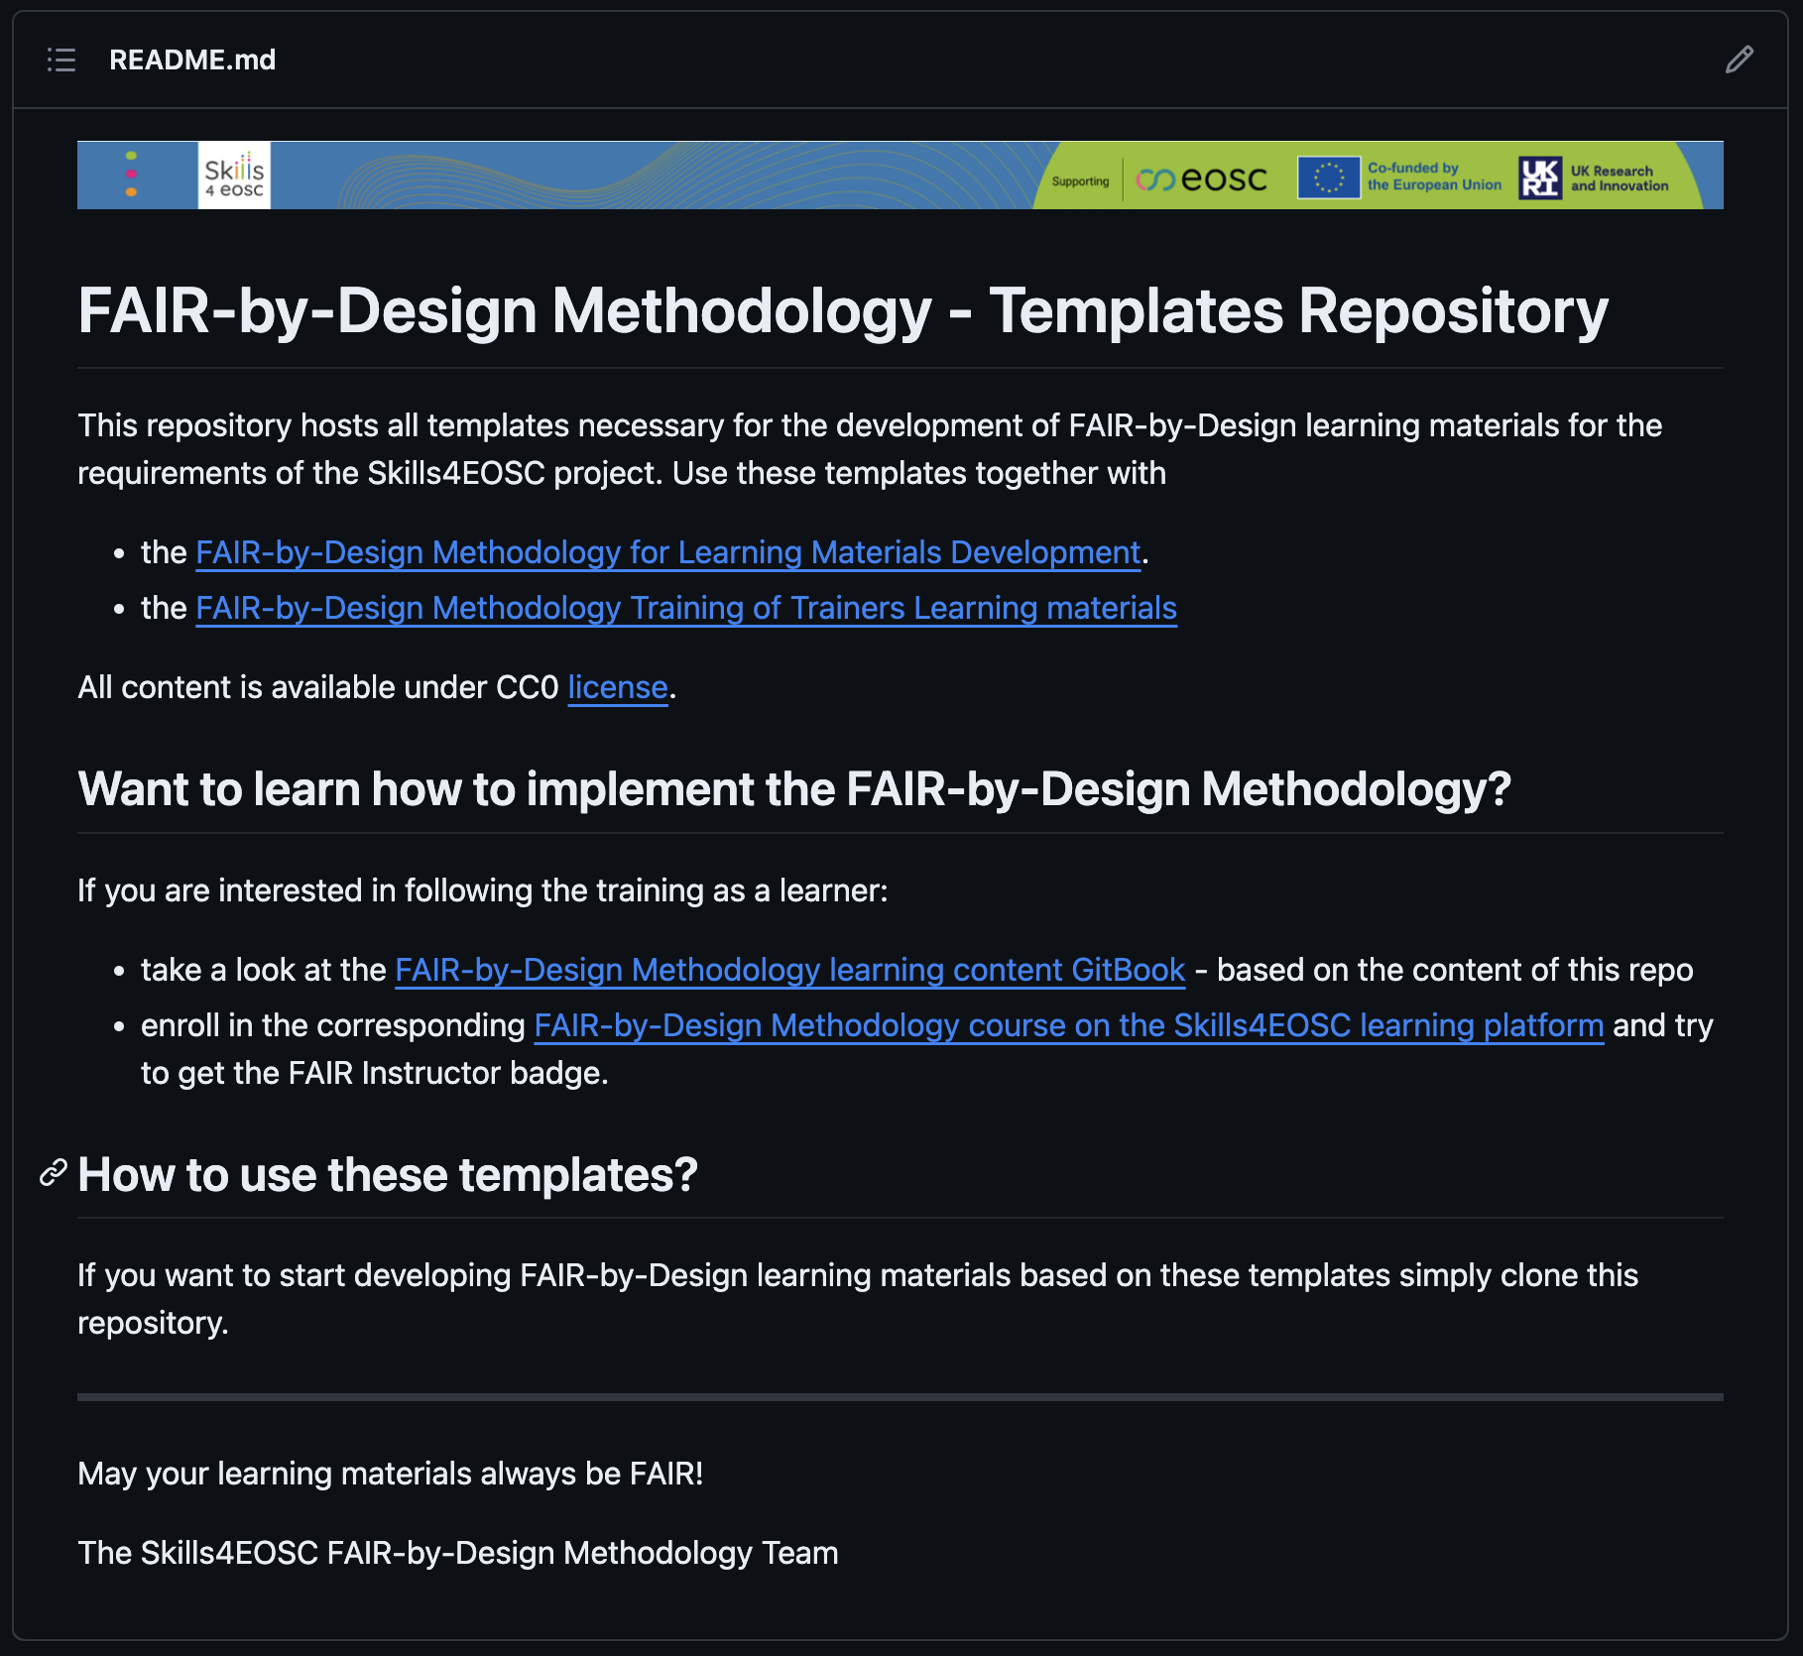
Templates Repository
https://github.com/FAIR-by-Design-Methodology/templates

Slide 56

Coffee Break ~ 10 mins

Slide 57
Back to the stages

Slide 58
produce

Slide 59

4 - Produce
Tools & Formats
Re-iterate & Finalize
Accessibility
Internal QA
Editable vs Final
Open file formats
Web & Multimedia friendly
Granular versioning
Collaborative environment
Cover the widest range of learners’ variability
w+w/o assistive technology
W3C WCAG 2.1(2.2)
PDF/UA
Back and forth iterations
Metadata = human + machine – readable
License
Facilitation Guide
Self-assessment
Quantitative: required elements
Qualitative: per LU

Slide 60
Q: When developing and maintaining learning resources for long-term use and collaborative contribution, which of the following practices is MOST critical?
Saving all files in a shared cloud drive with sequential file names (e.g., "Module1_v1," "Module1_v2").
Using a dedicated version control and collaboration system to track changes, manage contributions, and facilitate collaborative editing.
Sending updated files via email to all collaborators and maintaining a master copy on a personal computer.
Documenting all changes in a separate text file and manually updating the main document.

Slide 61
File Formats & Tools Examples
Editable content -> MD (+ PPTX)
Final content -> HTML + PDF
Granular versioning and collaborative environment -> GitHub

Slide 62
Learning modalities
Different ways individuals process and retain information
Key Modalities:
Visual
diagrams, charts, and images
Auditory
audio recordings, podcasts, and narrations
Reading/Writing
detailed written explanations, subtitles, and interactive reading materials
Kinaesthetic
ex. drag-and-drop activities and virtual labs
Tailoring content to diverse learning styles enhances engagement and retention

Slide 63
VARK & Skill levels
Novice Learners (Low Skill Level)
Visual & Kinaesthetic
Visual aids
Step-by-step demonstrations
Hands-on tasks
Intermediate Learners Developing Proficiency
Aural & Read/Write
Discussions, podcasts, or narrated presentations to reinforce concepts
Self-explanation tasks
More text-based materials
Advanced Learners High Skill Level, Expert
Kinaesthetic & Aural
Debates, presentations, peer-teaching
Unstructured real-world problems
Mentorship and coaching sessions where learners engage in discussion with experts
flowcharts, infographics, color-coded guides
videos, guided practice
labs, structured problem-solving exercises
learners write reflections or summarize ideas
case studies, in-depth readings
aural, kinaesthetic
case studies, simulations, research projects

Slide 64
Integrating multimedia into learning content
Address and engage various learning preferences
Types of Multimedia:
Images
Use descriptive alt text
Consider icons
Videos
Embed with HTML or provide links
Consider GIFs
Audio
Include transcripts and controls
Interactive Elements
Ensure compatibility and responsiveness
Provides varied methods of instruction and reinforces concepts

Slide 65
Do
Maintain a Consistent Style
Use consistent image sizes, captions, and positioning throughout your content
Test Compatibility
Ensure that the multimedia elements work in the Markdown processor or platform you’re using
Responsive Design
Ensure that your multimedia content is responsive, especially when using HTML, so that it looks good on different screen sizes
Provide Download Links for Media
Some users might prefer or need to download media files instead of viewing them directly in the browser
Documentation
Ensure that you provide clear documentation and context for users interacting with ex. Jupyter notebooks

Slide 66
DON’T
Don’t Overload Pages with Too Much Multimedia
Use multimedia sparingly and only when it adds value to the content
Don’t Use Low-Quality Media
Always use high-resolution images and clear audio/video files
Don’t Forget to Test Media Content
Always test embedded media on multiple platforms before publishing
Don’t Ignore Accessibility
Use alt text, provide transcripts for videos, and ensure that interactive elements are keyboard-navigable
Don’t Link to Unreliable External Sources
Host essential media content yourself or ensure that external links are stable
Don’t Use Auto-Playing Media
Always allow users to control when media plays
Don’t Neglect to Credit Sources
Always include proper citations or credits when using third-party media
Don’t Rely Solely on Multimedia
Pair videos with summaries, and images with descriptive captions

Slide 67

Accessible learning materials
Designed or later enhanced to be usable across the widest range of learners’ variability
directly used without assistive technology
made usable with assistive technology
examples
Cultural background
Native language
Learning styles
Physical impairments
This Photo by Unknown Author is licensed under CC BY-NC

Slide 68
Accessibility tips
present the information in multiple ways and formats
use simple language
use headings
use table of content
provide alternative text for images
use equation editors for math expressions
use a high contrast colour palette
don't use colour as the only way to convey information
use descriptive links
use tables only when required
provide closed captions and transcripts

Slide 69
Q: You have an image in your online learning module depicting a complex graph showing the correlation between global temperature anomalies and carbon dioxide levels over the past 100 years. Which of the following alternative text options is the MOST effective and accessible for all learners?
"Graph."
"Image of temperature and CO2 graph."
"A line graph showing global temperature anomalies (y-axis) and atmospheric carbon dioxide levels (x-axis) from 1920 to 2020. Temperature and CO2 levels both show a clear upward trend."
"Data visualization of climate change."

Slide 70
Alternative text
Alternative text guide by WebAIM
should be accurate and equivalent in representing content and function
should be concise
do not make it redundant
do not include phrases such as "image of ..." or "graphic of ..."
Decorative image = blank alternative text
does not present important content
is used for layout or non-informative purposes
does not have a function (e.g. is not a link)

Slide 71
Methodology again

Slide 72
publish

Slide 73
5 - Publish
Final preparations
To Repository
To LMS
Accompanying Files
For Instructors
For Learners
Readme
Citation
Code of conduct
LICENSE file
…
fair-checker
Add to Catalogue
Add final content
Configure assessment
Setup feedback
Add webinar room
Define credentials/badges

Slide 74
Define how-to cite for your own material
Option: Citation File Format (CFF)
CITATION.cff
Template provided in the FAIR-by-Design Methodology Template repository
https://citation-file-format.github.io/
Can be used to
generate a CFF
validate a CFF
Compatible with the ZENODO citation format

Slide 75
Q: Which of the following BEST describes the PRIMARY purpose of a Code of Conduct published alongside open learning resources?
To legally protect the intellectual property of the creators and prevent unauthorized distribution.
To establish a set of guidelines and expectations for respectful and inclusive behavior among contributors and users.
To provide detailed instructions on how to use the resource and report technical issues.
To outline the specific technical requirements and software dependencies for accessing the resource.

Slide 76
Collaboration
README
Provides essential information about the purpose, content, and usage of the learning materials.
Offers instructions on customization and contribution.
Helps users understand the context and scope of the resource.
Code of Conduct
Establishes clear expectations for behavior and communication within the community.
Promotes a respectful and inclusive environment for all contributors and users.
Helps to prevent and address conflicts or inappropriate behavior.

Slide 77
Q: Which is MOST important when aiming for FAIR publishing of the learning resource?
Ensuring the metadata is open, and accessible to all.
Making the module visually appealing.
Choosing a catchy title.
Hosting the module on a popular platform.

Slide 78
FAIR and Openness
FAIR doesn’t imply FREE and fully OPEN to EVERYONE
What must be made available to everyone to be FAIR is
the full metadata description
with clear access rules
In the case of working with closed materials
The collaboration platform has access rules
Materials are published in closed repositories and LMSs

Slide 79
Q: Which action LEAST contributes to making your module "Findable"?
Using relevant keywords in the module's description.
Submitting the module to relevant repositories.
Creating a detailed table of contents.
Designing visually appealing graphics for the module.

Slide 80
Aim for Findable learning content
Visuals are important, but they don't directly impact findability in search results.
Use a Persistent Identifier
Create Rich and Standardized Metadata
Publish on Repositories or Open Access Platforms
Use the right keywords in the title, description, and metadata
Share on Social Media and Networks
Integrate with Learning Management Systems (LMS)
Encourage Collaboration and External Sharing

Slide 81
Q: Choosing a stable URL or DOI for your module is crucial for ensuring it remains accessible over time.
True
False

Slide 82
Why PIDs?
Stable URLs and DOIs provide persistent links, preventing broken links and ensuring long-term access.
Long-term access and stability of links.
Easy citation and attribution for academic credibility.
Increased findability and discoverability via search engines and repositories.
Cross-platform compatibility and interoperability.
Tracking impact and usage to measure engagement and recognition.
Compliance with FAIR principles and supporting open access initiatives.
Version control to track updates and revisions.

Slide 83
Q: When publishing your module, which aspect is NOT directly related to "Interoperability"?
Using standard file formats (e.g., HTML, SCORM).
Providing metadata using a standardized schema.
Using SMART learning objectives.
Ensuring the module can be accessed on different devices.

Slide 84
Interoperability
Interoperability focuses on technical compatibility and exchange of information
Use standardized formats (e.g., SCORM, xAPI, LTI).
Integrate with LMS using tools like SCORM, LTI, or xAPI.
Leverage open APIs for content integration across platforms.
Make content responsive on different devices.
Use open data standards for linking content with external resources.
Encourage use of open standards for content delivery (xAPI, OpenID, OAuth).
Ensure content is linked and referenced for wider use and integration.

Slide 85
Q: Which action LEAST contributes to making your module "Reusable"?
Applying a Creative Commons license.
Including a comprehensive instructor kit.
Providing clear attribution information for any resources reused.
Hosting the module on a specific learning platform.

Slide 86
Reusability
Modular Design: Break content into small, independent units.
Open Standards and Formats: Use open, compatible formats and standards (SCORM, xAPI, LTI).
Clear and Flexible Metadata: Provide comprehensive metadata and licensing information.
Adaptability and Customization: Ensure content can be easily customized by others.
Accessibility: Follow accessibility guidelines (WCAG) and ensure compatibility with different devices.
Modular Learning Objectives and Assessments: Design objectives and assessments that are flexible.
Instructions for Use: Provide clear guidelines on how to implement and modify the content.
Easy Access and Sharing: Host materials on open platforms and allow easy downloads.
Collaboration and Feedback: Encourage collaboration and provide version control.
Test for Reusability: Pilot test the module to ensure it is adaptable and reusable.

Slide 87
Machine-readable metadata
Landing page of the learning resource
Should lead to syllabus with huma—readable metadata
To add machine-readable metadata
Use metadata in HTML head
Use FAIR Signposting
A method to expose machine-actionable navigation links developed by FAIR-IMPACT
Two levels of compliance
Level 1 = minimal set of typed links with the landing page as the link origin.
Level 2 = comprehensive set of typed links for landing pages, content, and metadata resources.
Example:
View page source on: view-source: https://fair-by-design-methodology.github.io/IDCC25workshop/latest/

Slide 88
Fair by design overview

Slide 89
verify

Slide 90
6 - Verify
FAIR-by-Design QA checklist
Required vs optional
Review w/o cognitive bias
From a new learner perspective
Setup gathering from both perspectives
QA checklist
Level of FAIRness
External QA
Feedback QA
LMS QA

Slide 91
Minimum FAIR Requirements
F
Metadata is provided in human- and machine-readable format
Resource is indexed in at least one searchable repository
A
Accessibility of all learning resource files checked
Access rules (authentication & authorisation) defined for the learning resource
I
The RDA minimal (or domain specific) metadata schema is used
Resource is available in open file formats
R
Clear attribution is provided for all reused resources with compatible licenses
Resource has a permissible license that allows derivations

Slide 92
Self-Check QA
it is imperative that you first go through a self-check phase to ensure everything is as intended
use the QA guidelines and checklists developed by Skills4EOSC
General QA checklist
focuses on the learning materials content and analyses it from a learners' perspective
FAIR-by-Design QA checklist
focuses on the FAIR aspects of the learning materials and requirements imposed with the use of the methodology

Slide 93
External QA
A pair of fresh eyes that will review the learning materials without any cognitive bias
Evaluate the learning materials quality and suggest improvements using an objective and independent perspective
can use the QA guidelines and checklists
should be encouraged to perform in-depth review process
High impact recommendations in the QA review report should be resolved as soon as possible
Lower-level improvement recommendations can be considered as relevant input for the continuous improvement step

Slide 94
Learner QA
Ensure that the learners can access and use the content
For instructor-led trainings and courses this must be done before the scheduled activity takes place
Assume the role of a learner and test everything
Any identified problems should be resolved as soon as possible

Slide 95
Q: Which method is BEST for gathering feedback from learners after they consumed the learning content?
Survey
Focus group
Usage statistics
All of the above (Survey, Focus group, Usage statistics)

Slide 96
Getting Feedback
A combination of methods provides the most comprehensive feedback.
Surveys can reach a large number of users
Focus groups allow for in-depth discussion
Usage statistics provide quantitative data

Slide 97
Which of the following is NOT a typical aspect of verifying the effectiveness of a learning module?
Collecting feedback from learners
Analyzing learner performance data (e.g., quiz scores)
Tracking module usage statistics
Promoting the module to new audiences

Slide 98
Verifying
Verification focuses on evaluating the module's impact on learning.
Ensure Findability: Verify unique identifiers and comprehensive metadata.
Ensure Accessibility: Check that materials are open access and usable by all learners.
Ensure Interoperability: Confirm compatibility with common formats and systems.
Ensure Reusability: Verify clear licensing and modular structure for reuse.
Validate Learning Outcomes: Ensure alignment with objectives and effective assessments.
Verify Quality and Accuracy: Ensure correctness, up-to-date content, and pedagogical soundness.
Engage Stakeholders: Gather and act on feedback from learners and educators.
Ensure Sustainability: Confirm long-term accessibility and track ongoing usage.

Slide 99
Round we go

Slide 100
Continuous Improvement

Slide 101





Continuous Improvement
Reported issues
Discussion forum
Direct mail contact
Other means of communication
Select items from the list that will be part of a new version
2017
Internal
External
Analyze
Improve
Repeat
Feedback form
QA recommendations
Self-reflection after training
Create a list of potential improvements with impact level (high, moderate, low)
Start a new cycle of the FAIR-by-Design methodology

Slide 102
Q: You receive feedback that some researchers found the module too technical. Which action would be MOST appropriate for continuous improvement?
Revise the module to simplify the language, provide more examples, and add a glossary of terms.
Ignore the feedback, as some level of technical detail is necessary.
Create a separate, more advanced version of the module.
Remove the technical content entirely, even if it is essential.

Slide 103
Always Improve
Simplifying language and adding examples makes the module more accessible to a wider audience without sacrificing essential content.
Continuous improvement allows learning modules to stay relevant, effective, and engaging over time.
It helps you respond to learner needs, incorporate new technologies, and ensure quality and consistency.
It enhances learning outcomes, keeps content innovative, and makes materials more adaptive to changing educational contexts.

Slide 104
Q: Continuous improvement is a one-time activity we do after the initial test launch of the module.
True
False

Slide 105
Iterative process
Continuous improvement is an iterative process. Feedback should be collected and the module should be revised regularly to ensure it remains effective and relevant.
Ensures Relevance: By continually adapting based on feedback, you ensure that the module stays up-to-date and reflects the latest research and educational trends.
Improves Learner Engagement: Iteration helps keep the material engaging, as adjustments are made to meet the evolving needs of learners and the educational environment.
Enhances Learning Outcomes: The focus on regular improvements means that the module can be tailored to achieve the best learning results over time, aligning with learners’ changing needs and feedback.

Slide 106
Why versioning?
Address the challenges of constant changes to improve learning materials
Git as a versioning system provides industry standard version management
Consistency in the numbering is crucial

Slide 107

New iteration
New version number for a new release
Increment the Patch number in case of only technical fixes
Increment the Minor number if the incremental improvement does not change the overall structure of the learning materials.
Increment the Major number if the changes include change in the overall structure of the learning materials.

Slide 108
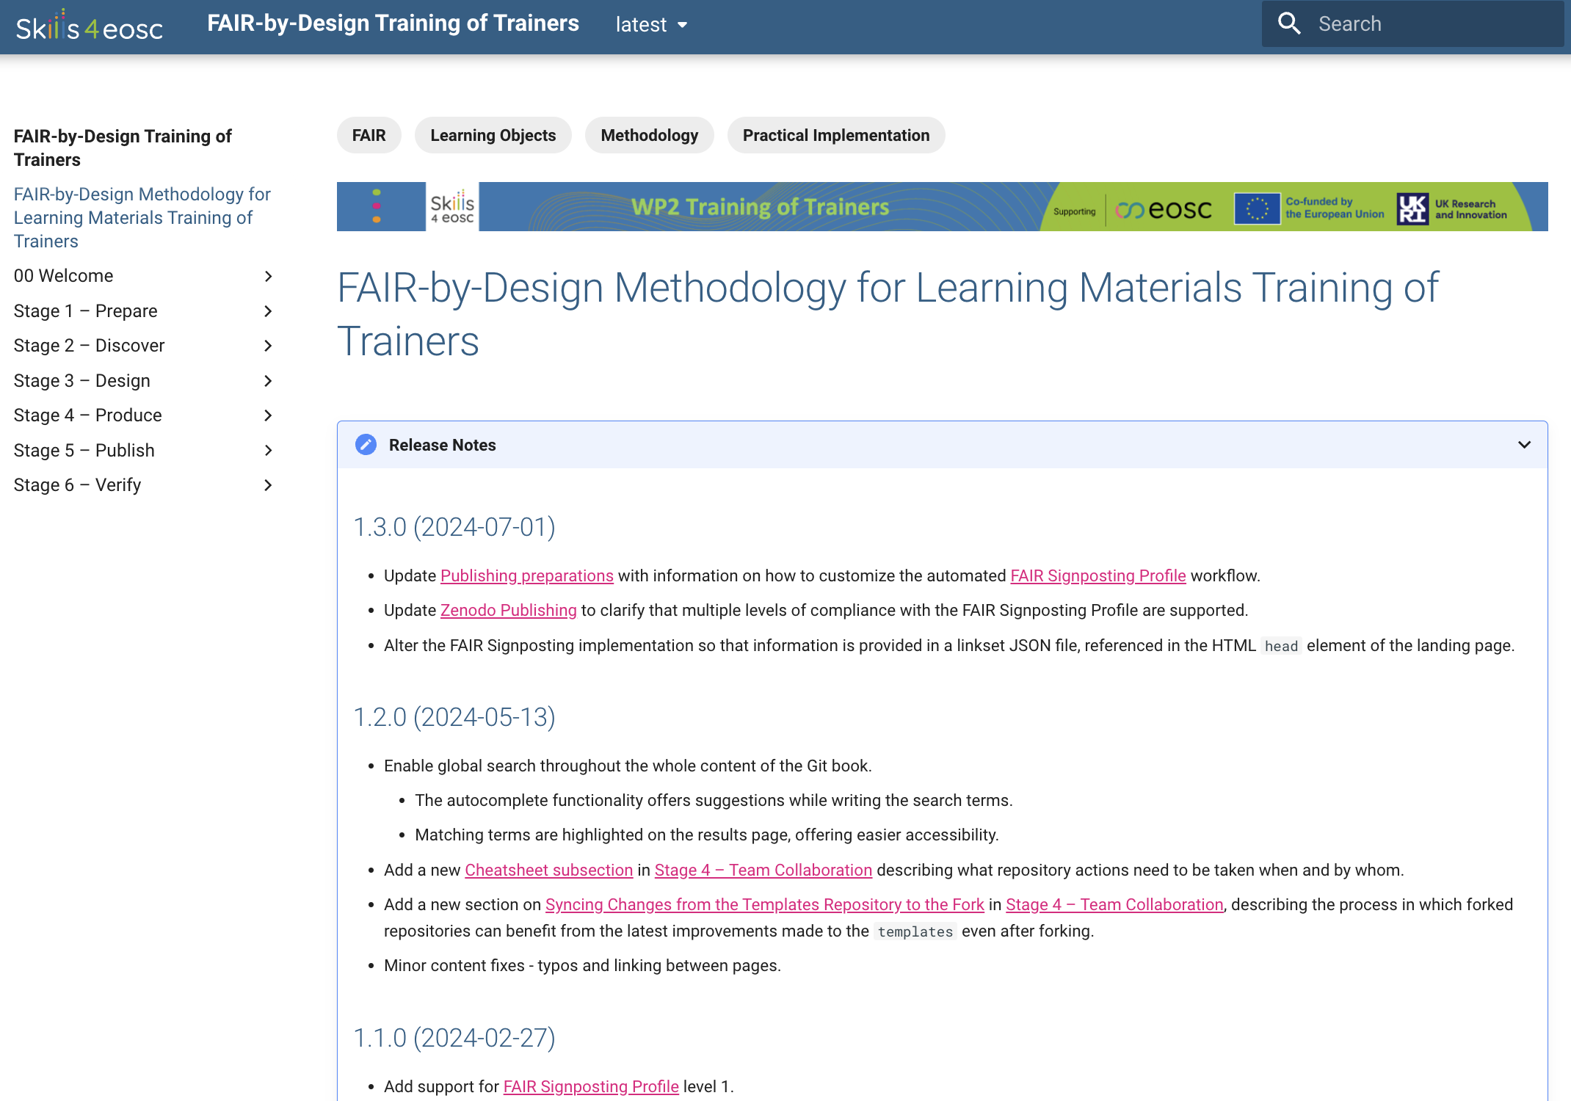
Release notes

Slide 109
FAIR-by-Design Methodology More Details….
Up-to-Date Methodology
https://fair-by-design-methodology.github.io/FAIR-by-Design_Book/
ToT course on Skills4EOSC LMS
https://learning.skills4eosc.eu/course/view.php?id=19
Training Gitpages
https://fair-by-design-methodology.github.io/FAIR-by-Design_ToT/latest/
https://fair-by-design-methodology.github.io/microlearning/latest/

Slide 110


FAIR-by-Design Methodology Quick Guide
https://doi.org/10.5281/zenodo.14930618
https://doi.org/10.5281/zenodo.14711525

Slide 111

Help us improve
We are very interested in your thoughts and ideas
Let us co-create and make a new, improved, version of the FAIR-by-Design materials together
EC Survey is always open

Slide 112

Thank you! Questions?
Credit: Some of the slides in this presentation were created by SlideEgg

